Slide 1
Airspace Integration of Launch and Reentry Operations

Slide 2
Overview
Risk Assessment and Aircraft Hazard Area Development
Mission Planning
Traffic Flow Management
Real-Time Mission Support
Post Operations Analysis
FAA Air Traffic Organization
Airspace Integration of Launch and Reentry Operations

Slide 3
Space Operations Overview
Space Operations
Safe Integration of Space Launches

Slide 4
Federal Aviation Administration
Office of Commercial Space Transportation (AST)
License/Permit, Regulate and Inspect United States commercial space industry
Air Traffic Organization
(ATO)
Integrate launch and reentry operations, commercial and non-commercial into the National Airspace System (NAS)
ATO System Operations (AJR)
ATO Space Operations (AJR-1800)

Slide 5
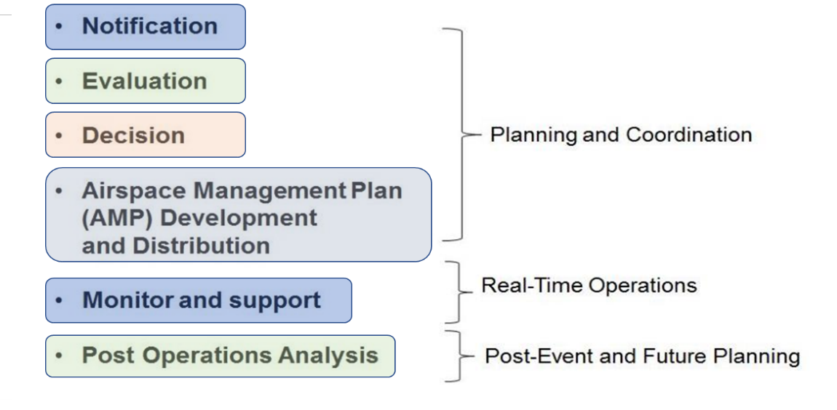
FAA Air Traffic Organization Space Operations
Our Mission: Ensure space launch and reentry operations are safely and efficiently integrated into the National Airspace System (NAS)

Slide 6
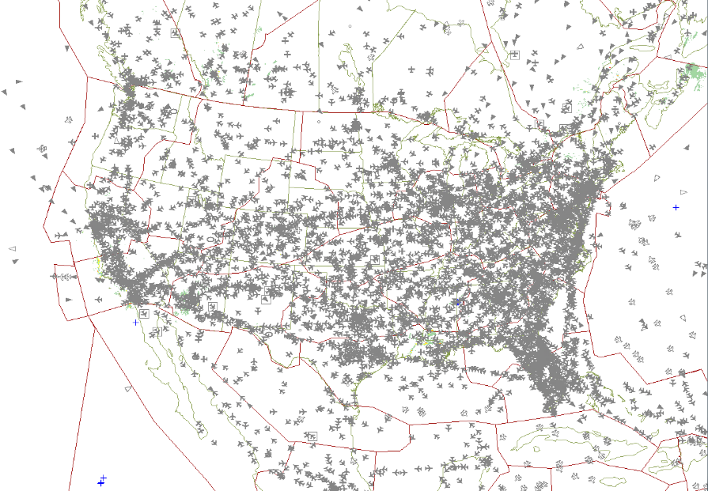
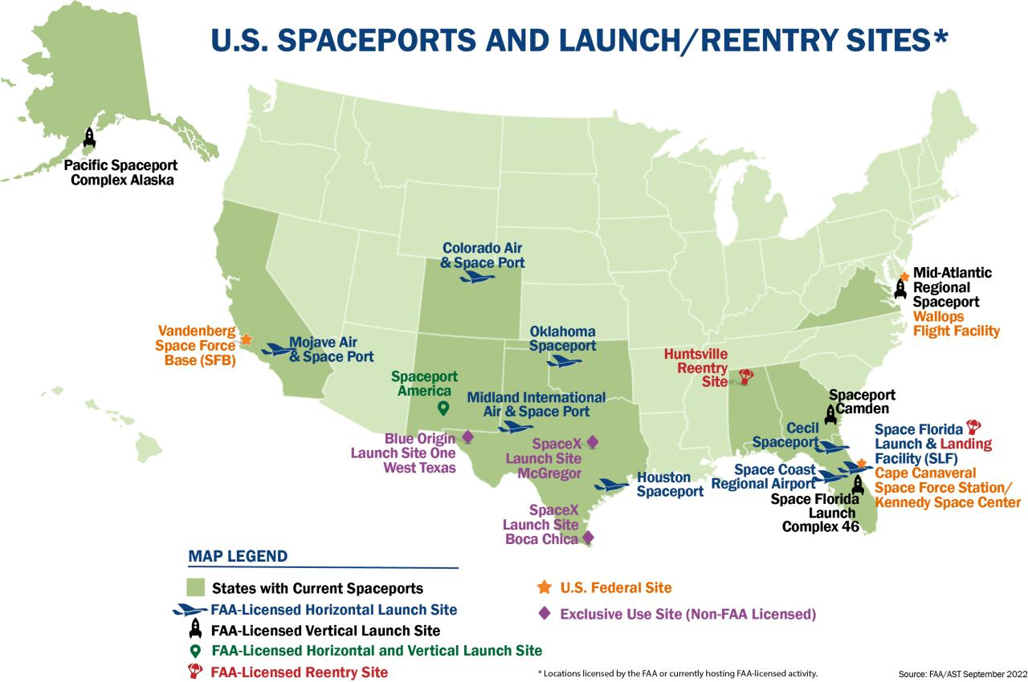
Notes:
Present day Spaceports with additional proposals.
Note the Spaceports that are within SUA
--Space Port America
--Mohave

Slide 7
Common Themes
Shared situational awareness among operator, range/spaceport and Air Traffic Control (ATC)
Collaboration between operator, range/spaceport, ATC, and international stakeholders

Slide 8
Airspace Integration
Risk Assessment and Aircraft Hazard Area Definition

Slide 9
Risk Assessment
Risk assessment performed by operator, range/spaceport and/or regulator
Air, Sea, and Land risks are assessed and have different thresholds
Aircraft Hazard Areas (AHAs) defined by regulation and policy as 1x10⁻⁶ for casualty-producing collisions
FAA ATO adds additional non-regulatory requirements associated with space operations “Acceptable Level of Risk (ALR)”
ALR was added to bridge the gap between regulatory requirements 1x10⁻⁶ and ATO target level of safety of 1x10⁻⁹
Risk Assessment also includes debris fall times associated with nominal and malfunction

Slide 10
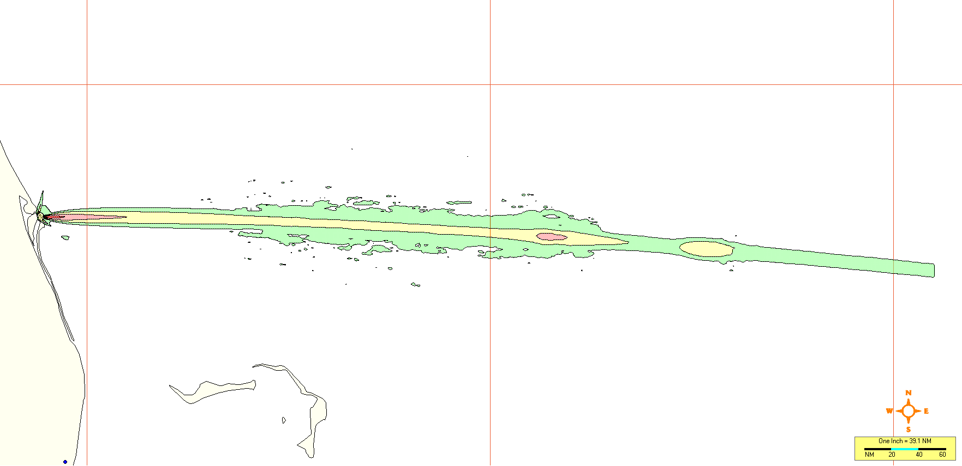
Risk Assessment
Risk Analysis: Risk contours are developed representing the risk to aircraft operations in the vicinity of launch or reentry operations
Green Contour = 1x10⁻⁸ Risk
Yellow Contour = 1x10⁻⁷ Risk
Light Red Contour = 1x10⁻⁶ Risk
Red Contour = 1x10⁻⁵ Risk

Slide 11
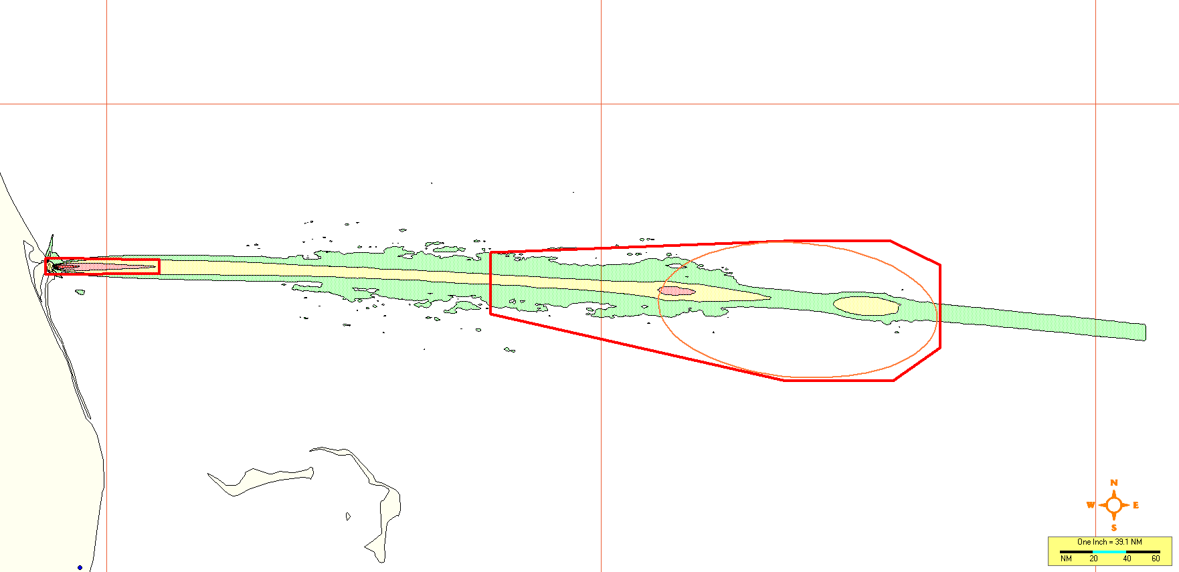
Risk Assessment
Aircraft Hazard Areas (AHAs): AHAs are developed to contain the risk contours that represent 1x10⁻⁶ risk to aircraft operations
Red Line/Box = AHA
Green Contour = 1x10⁻⁸ Risk
Yellow Contour = 1x10⁻⁷ Risk
Light Red Contour = 1x10⁻⁶ Risk
Red Contour = 1x10⁻⁵ Risk

Slide 12
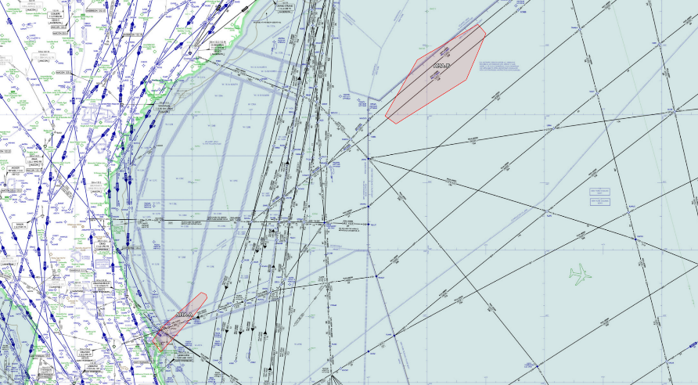
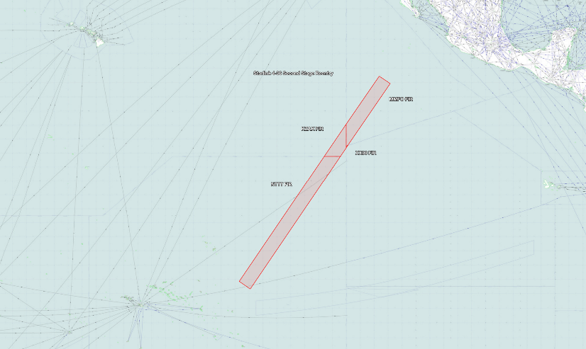
Risk Assessment
AHAs: AHA are implemented for different stages of a launch operation
Vehicle launch and ascent area
Jettison item area
Stage reentry area
Launch AHAs
Jettison Item AHA
Ascent AHA
Reentry AHA

Slide 13
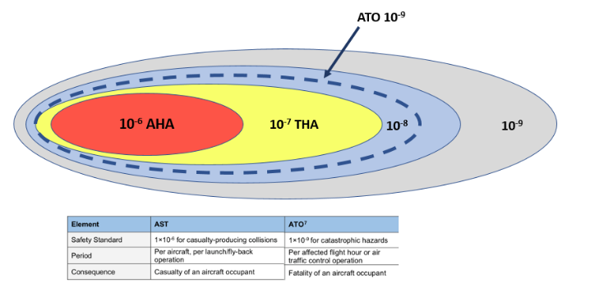
Risk Assessment
Green Contour = 1x10⁻⁸ Risk
Yellow Contour = 1x10⁻⁷ Risk
Light Red Contour = 1x10⁻⁶ Risk
Red Contour = 1x10⁻⁵ Risk
Acceptable Level Of Risk (ALR):
ALR was added to bridge the gap between regulatory requirements and ATO target level of safety of 1x10⁻⁹
1x10⁻⁷ Hazard Areas are Debris Response Areas (DRAs), which are used as a contingency in the event of a launch malfunction. DRA activation times are calculated using the risk analysis malfunction times
1x10⁻⁸ Hazard Areas are used for data collection associated with annual collective risk thresholds

Slide 14
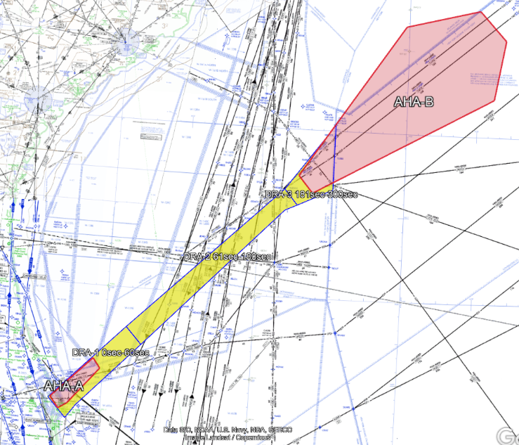
Risk Assessment
New Procedures – Debris Response Areas (DRAs):
Real-time ATO response to a debris-generating event:
Appropriate DRA will be activated based on the time of the vehicle malfunction
DRA will be evacuated and remain sterile until all debris has fallen to earth
DRA durations are pre-calculated and known prior to the launch
Applied in radar-controlled airspace only
DRA #1
DRA #3
DRA #2

Slide 15
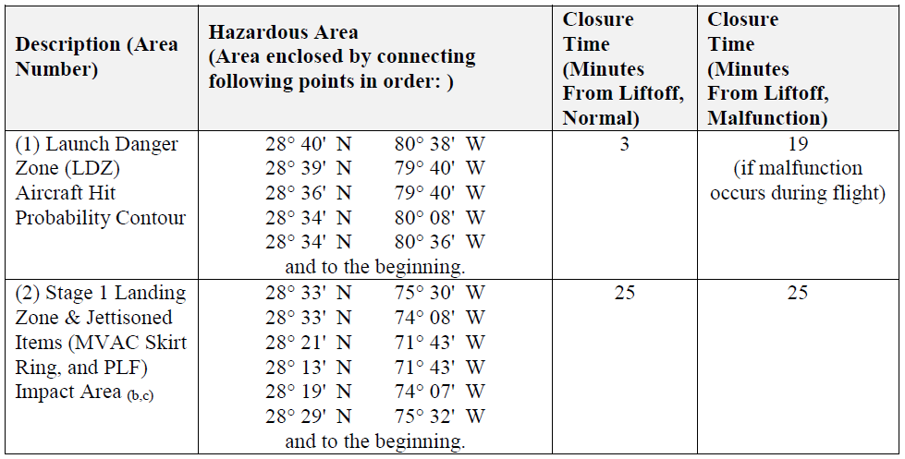
Risk Assessment
Nominal
Malfunction
Risk Analysis:
AHA Activation Times
Nominal operations
Malfunction operations
(debris fall time)

Slide 16
Airspace Integration | Module
Mission Planning

Slide 17
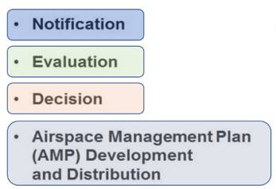
Mission Planning
Summary 5-Step Process: (typical operation)
Operator notification of intent to launch – 10 days prior
Mission Engineers create images and load SDI – 10 to 8 days prior
Evaluation/Analysis of mission specifics – 7 to 5 days
Stakeholder outreach – 4 to 1 days (i.e. Airspace Management Plan)
Hotline Activation and Launch – day of operation
Planning and Coordination

Slide 18
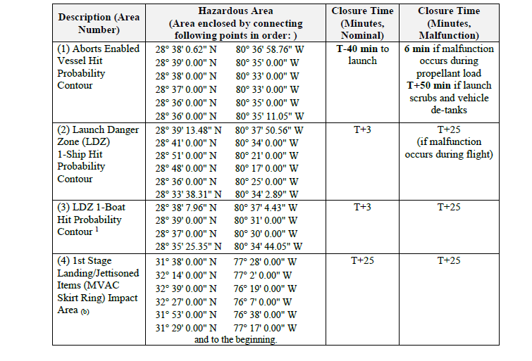
Mission Planning
Operator Intent to Launch
Notification:
Operator intent
Dates
Primary
Back up
Launch window
Intended launch time(s)
Risk analysis products
AHA definition
Nominal closure times
Malfunction closure times
Reentry times
Range Safety Analysis

Slide 19
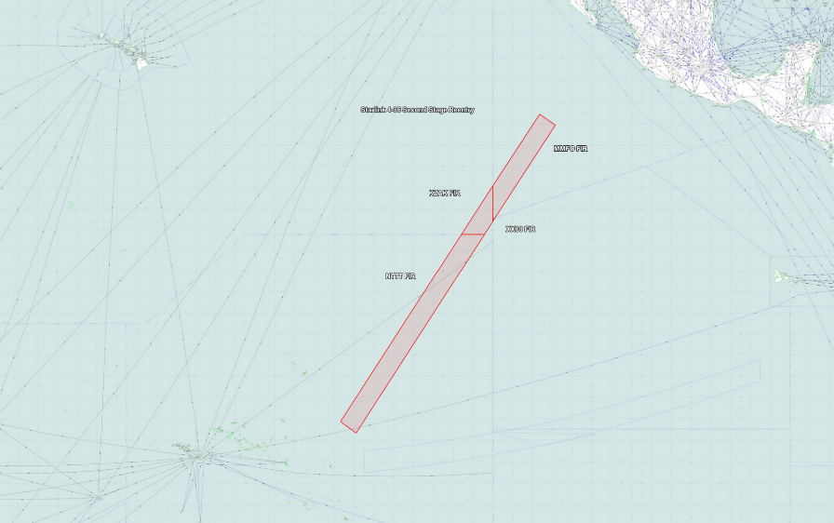
Launch AHAs
Mission Planning
Jettison Item AHA
AHA Definition:
Lateral AHA dimensions
Launch window
Malfunction times
Launch window = 0205-0432 UTC
Malfunction times: AHA A = 25 mins
AHA B = 47 mins
Activation Time = Launch Window + Malfunction Time
AHA A activation = 0205-0457 UTC
AHA B activation = 0205-0519 UTC
Ascent AHA
Reentry AHA

Slide 20
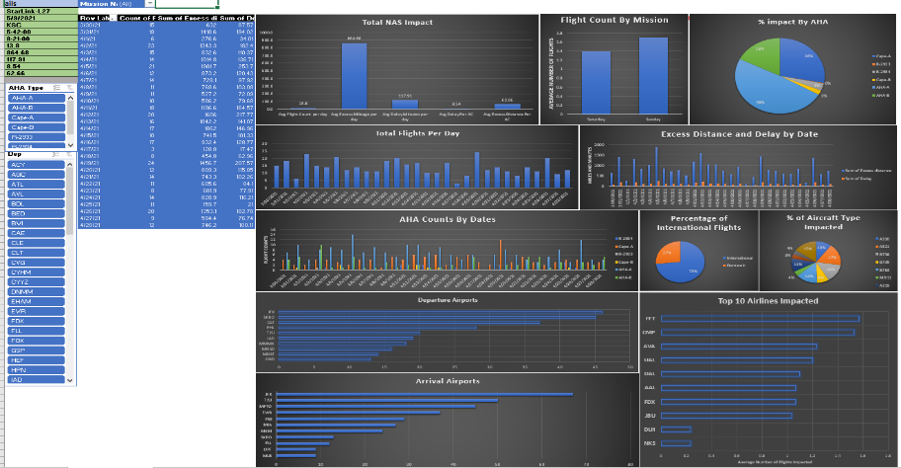
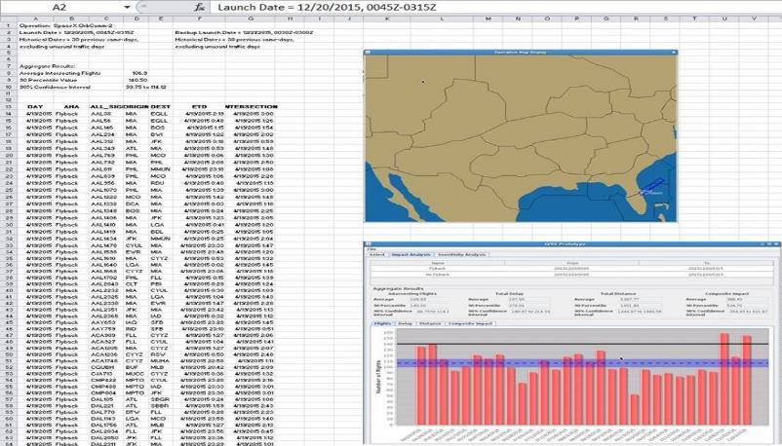
Mission Planning
Evaluation: Assessment of impacts on airspace system is performed using
AHA definition
Historical aviation traffic data

Slide 21
Mission Planning
International Coordination
Process typically initiated 10 days before launch
ATO Space Operations initiates coordination with International Air Navigations Service Providers (ANSPs) and U.S. NOTAM Office
Danger Areas published for hazard
Aeronautical Messaging Handling Service (AMHS) preferred method of coordination

Slide 22
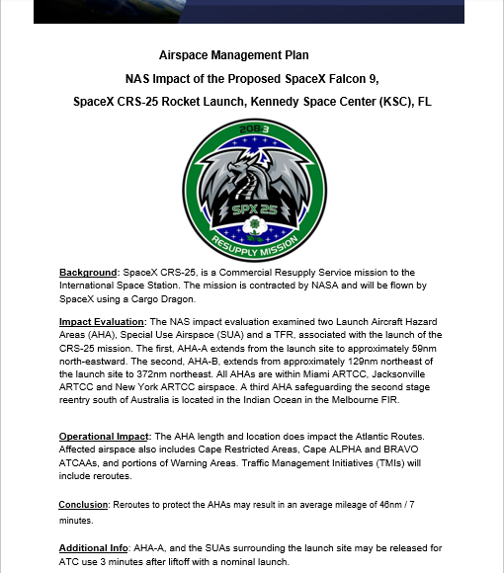
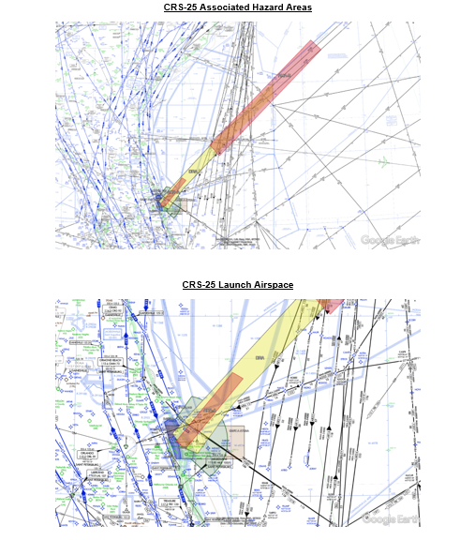
Mission Planning
Airspace Management Plan:
Mission Overview
Mission Schedule
Traffic Management Initiatives
Distribution:
LRO
Range
ATC Facilities
Aviation Community
Other Stakeholders

Slide 23
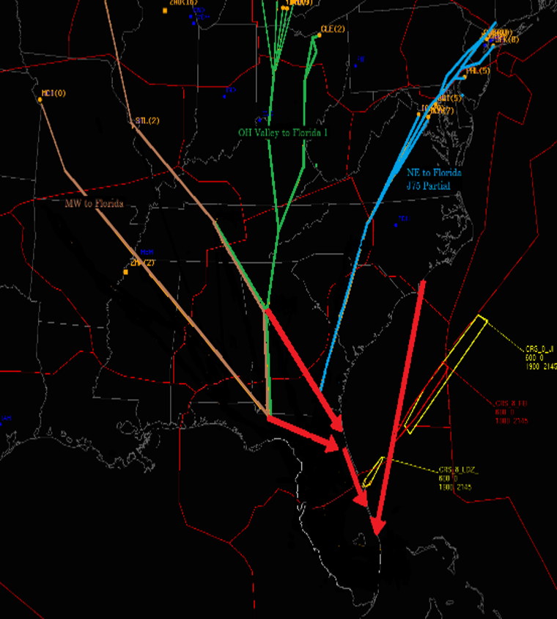
Airspace Integration | Module
Traffic Flow Management

Slide 24
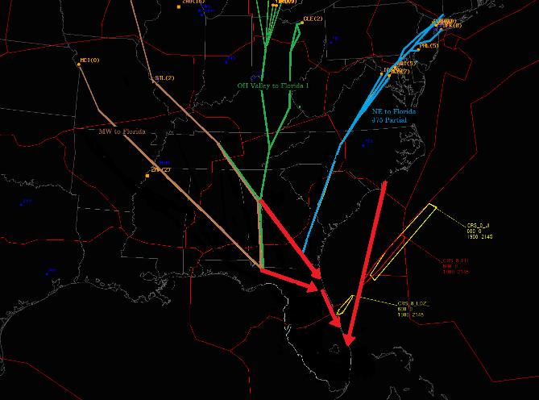
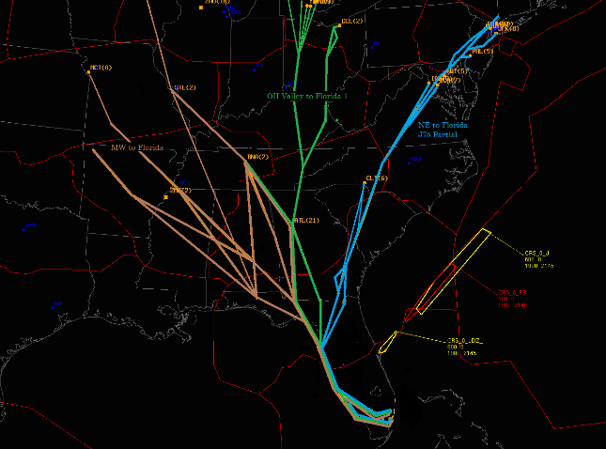
Traffic Flow Management:
Traffic management predominately consists of route management
Use of time-based procedures minimizes the total impact of operations
Real-time situational awareness is key to tactical management of airspace and aircraft during operation
Collaborative discussions with the space industry have been critical to understanding operations and the development of dynamic airspace management procedures
Early communication of traffic management plan to the aviation industry is important (i.e. planning telcon)

Slide 25
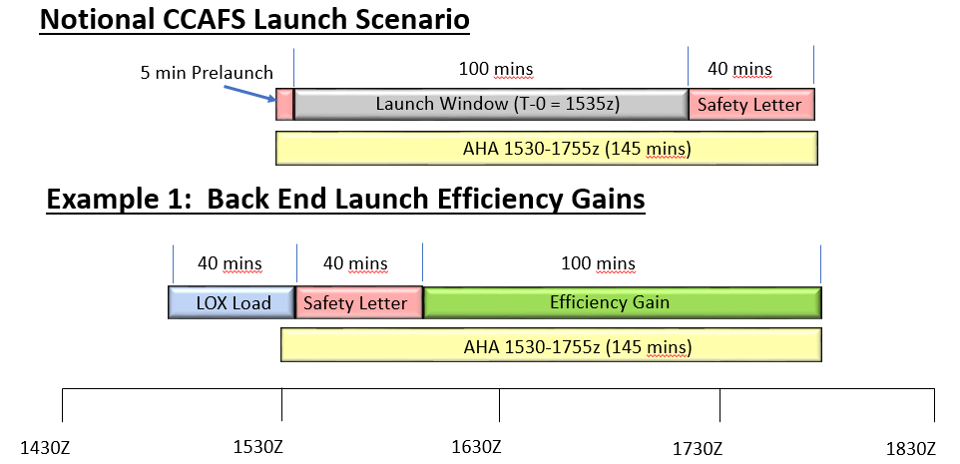
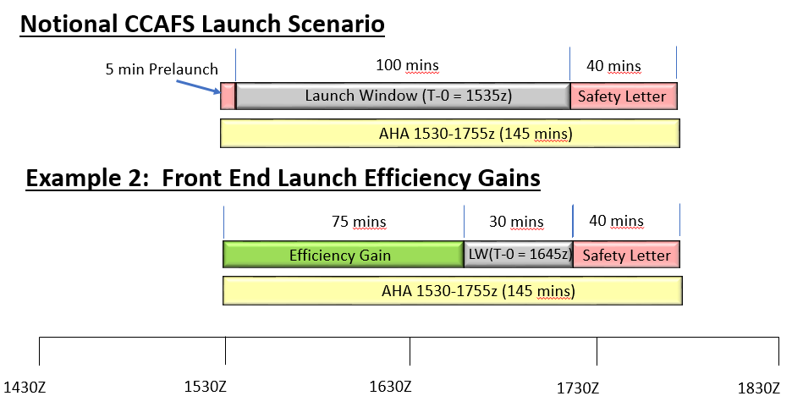
Traffic Flow Management:
Use of time-based procedures minimizes the total impact of operations
Importance of hotline in tactical management of aircraft during operation
Collaborative discussions with industry have been critical to understanding operations and the development of dynamic airspace management procedures

Slide 26
Airspace Integration | Module
Real-Time
Mission Support

Slide 27
Real-Time Mission Support
Mission: Ensure space launch and reentry operations are safely and efficiently integrated into the National Airspace System (NAS)
Conducted from the Challenger Room at the FAA Air Traffic Control System Command Center in Warrenton, Virginia.
Key Tools:
Space Data Integrator (SDI)
Traffic Flow Management System
Hotline

Slide 28
Real-Time Mission Support
Hotline Actions:
The hotline is key to real-time shared situational awareness
Operator call out of key mission events
Airspace is tactically managed and deactivated (TBLP/DLRW)
Traffic Management initiatives are canceled
In the event of a launch malfunction, Debris Response Areas (DRAs) are activated and canceled
DoD Commands
NORAD
ATC Facilities
Commercial Range
Federal Range
Operator

Slide 29
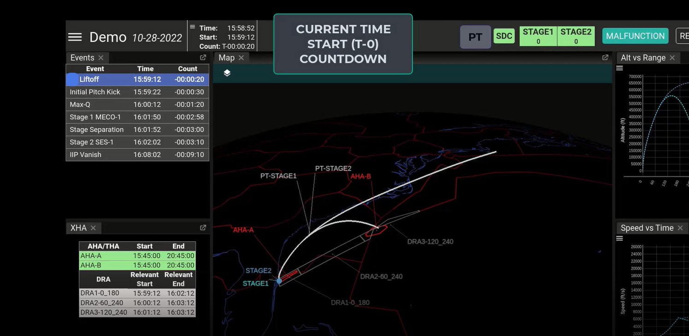

Slide 30
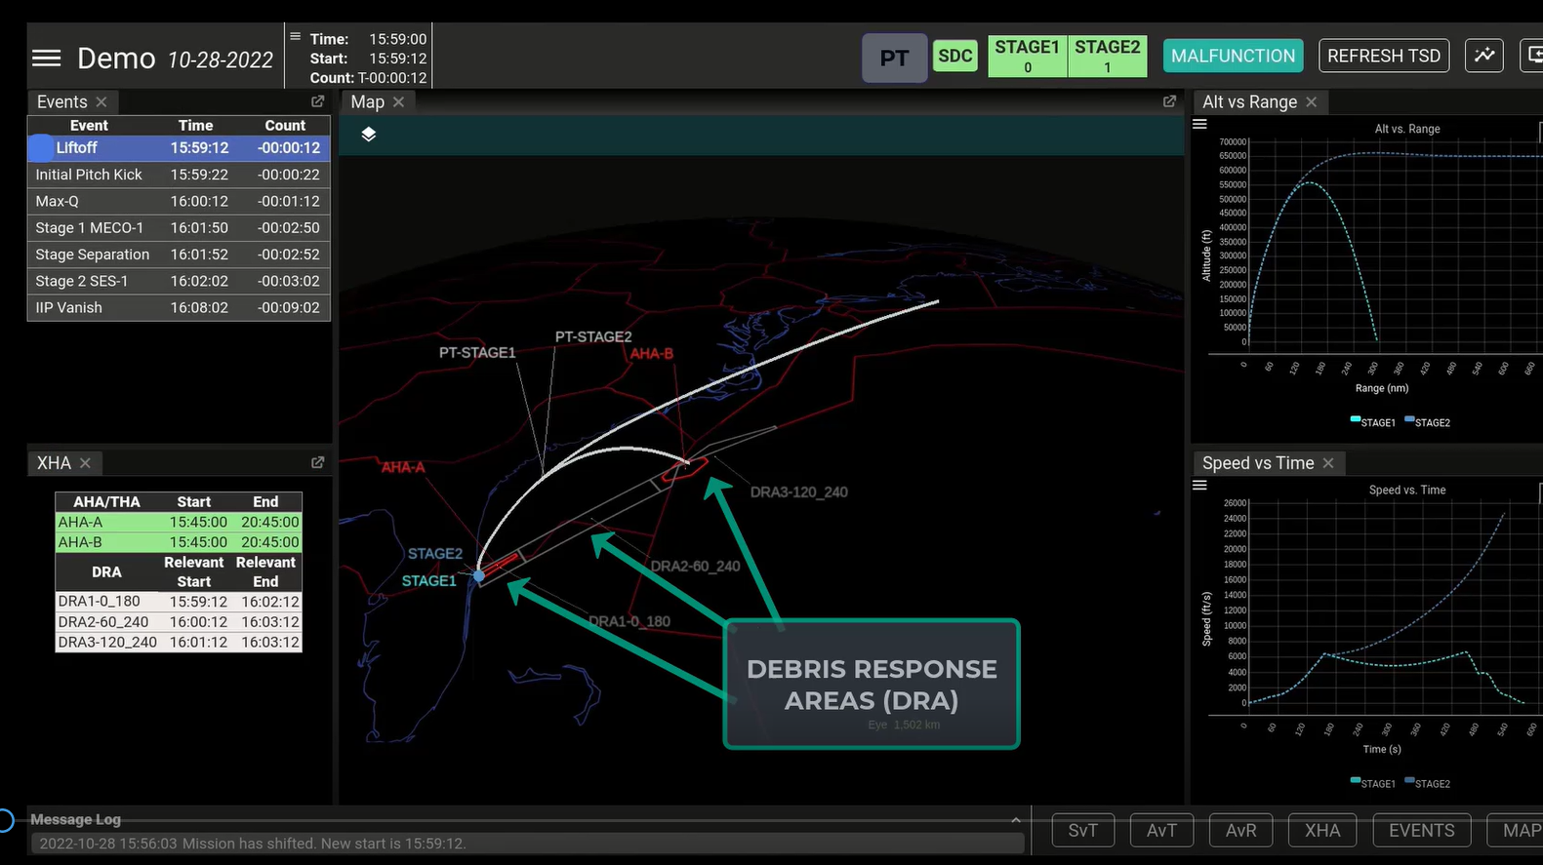

Slide 31
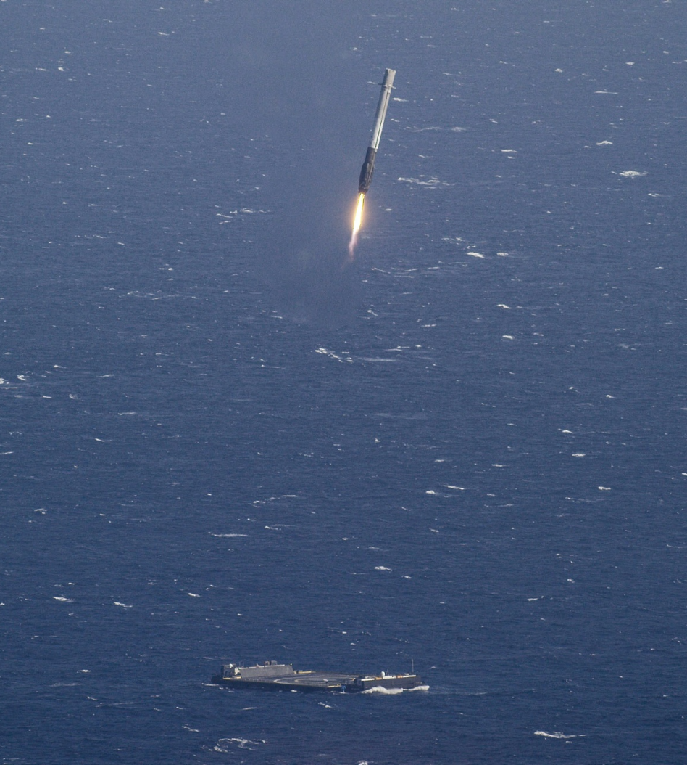
Airspace Integration | Module
Post Operations Analysis

Slide 32
Post Operations Analysis
Data Analysis
Lessons Learned
Best Practices

